Slide 1
NanoShine
Say goodbye to plaque and caries!

Slide 2
Interview Process
In-person friends
Dentists
#42 interviewees
In-person interviews of our friends, family, and professors.
Asking dentists.
Interviews
Google forms
In-person random
Passing out the google survey.
Asking people in the JFF hallway including students and guards.

Slide 3
Hypothesis Rejected/Accepted

Slide 4
Insights & Initial Findings
Education
Willing to try
Education about the problem is a significant part. (How do we effectively educate?)
People are willing to give Nanoshine a try.
Network effect
Product feel
Friends and family members have a huge influence on oral hygiene product usage
Customers want to feel the product (tangible feeling of the effectiveness of the product)
Notes:
Lot of people do not often visit the dentist.

Slide 5
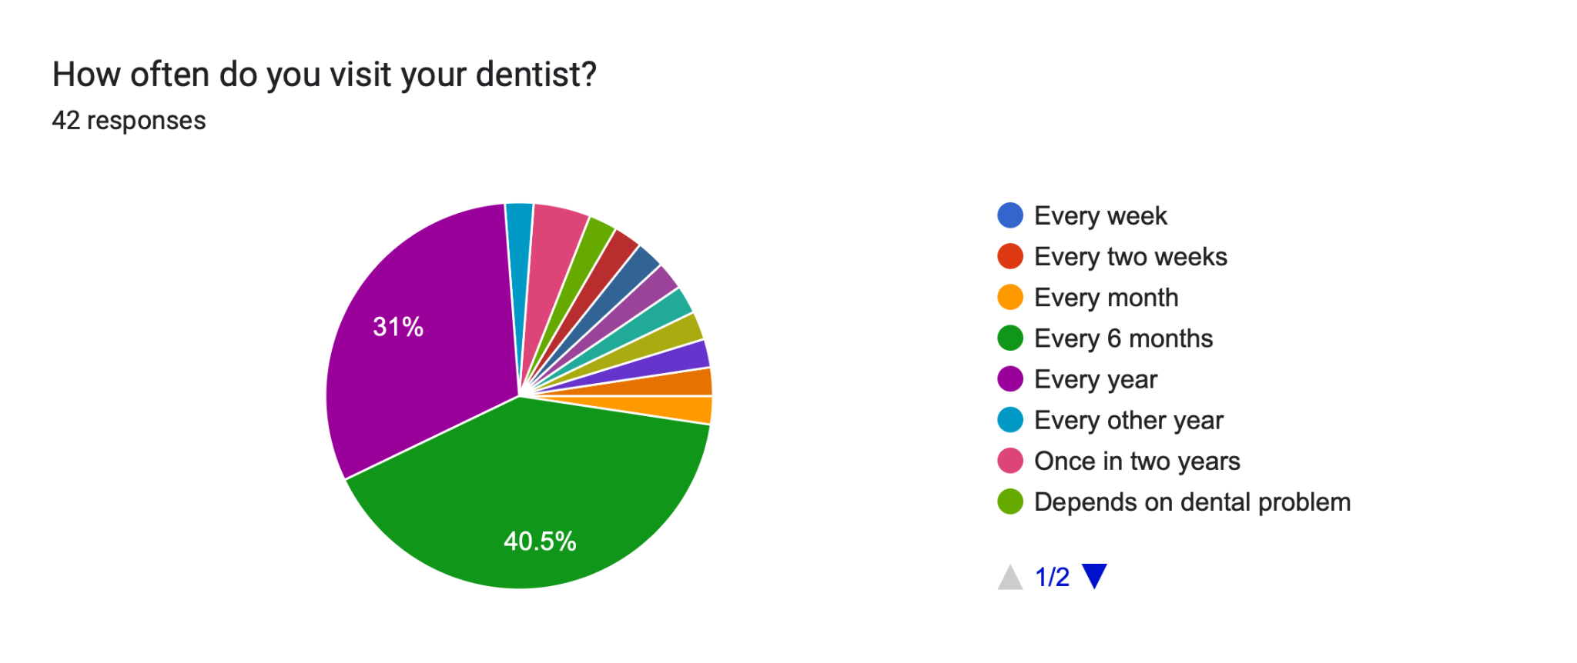
Surprise #1: Customers visit dentists infrequently

Slide 6
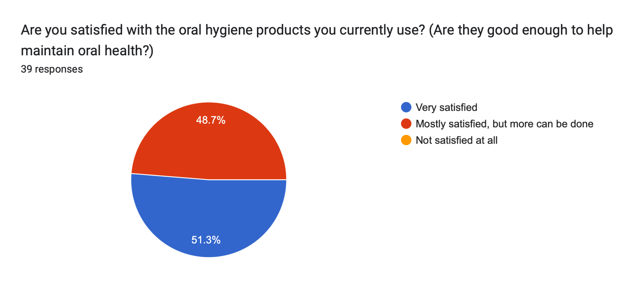
Finding #1: Customers are willing to try

Slide 7
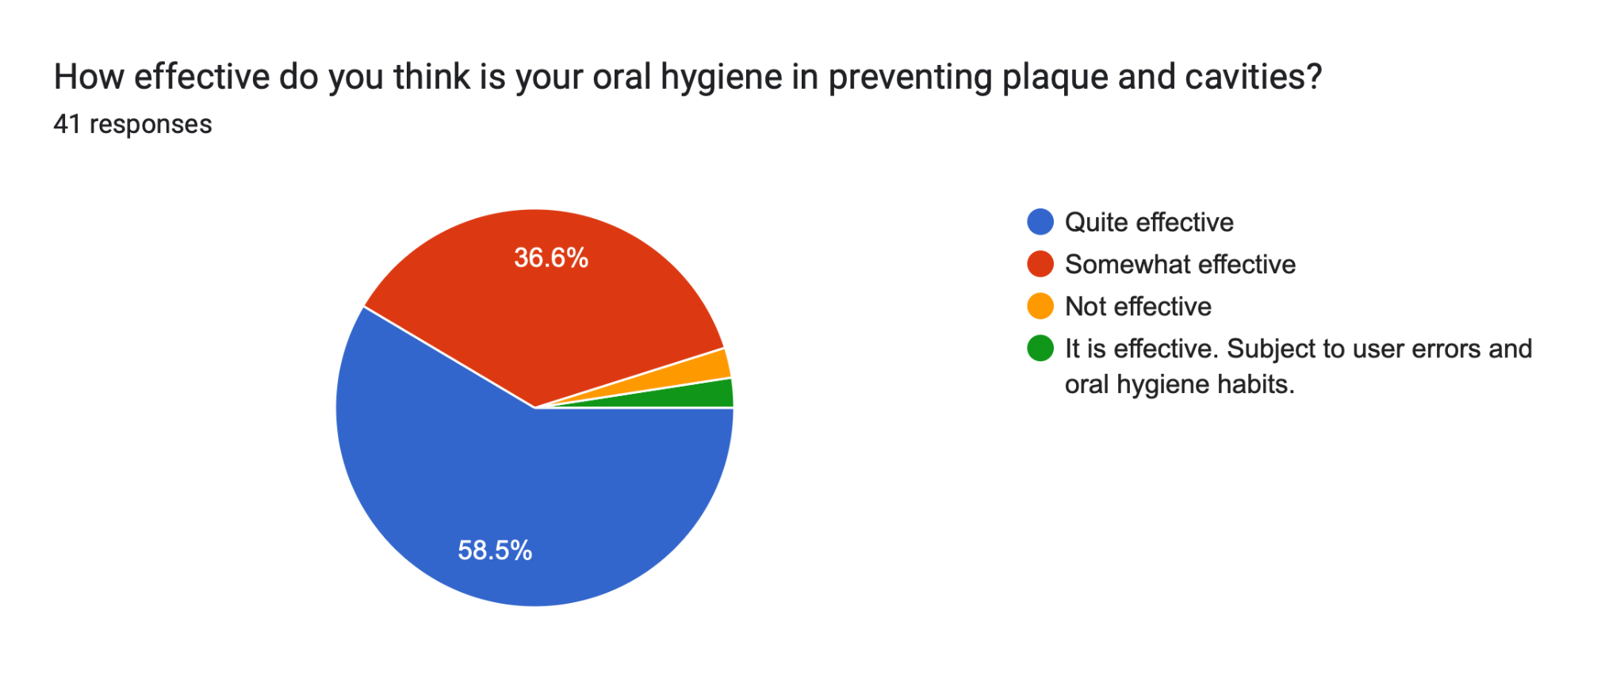
Finding #1: Customers are willing to try

Slide 8
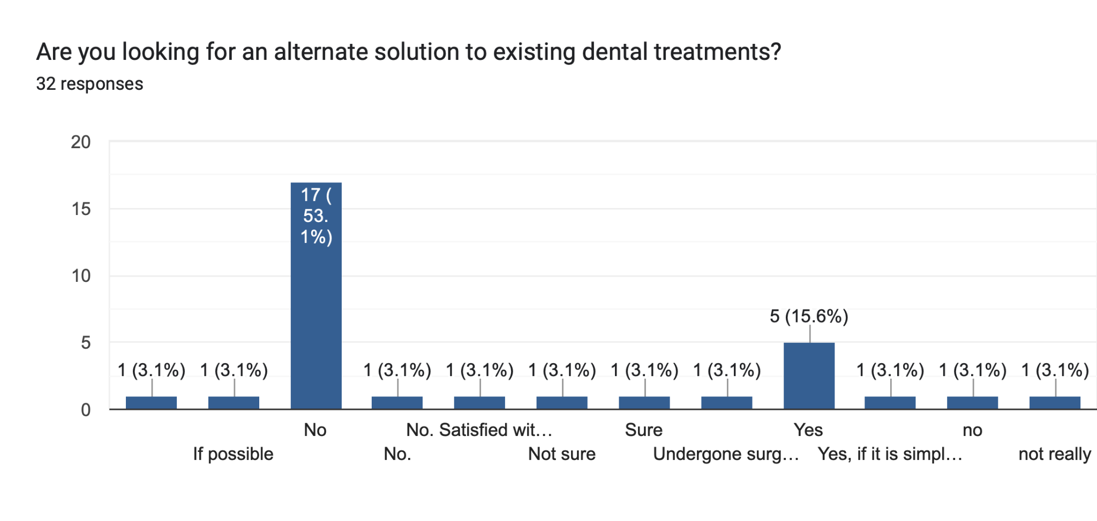
Finding #1: Customers are willing to try

Slide 9
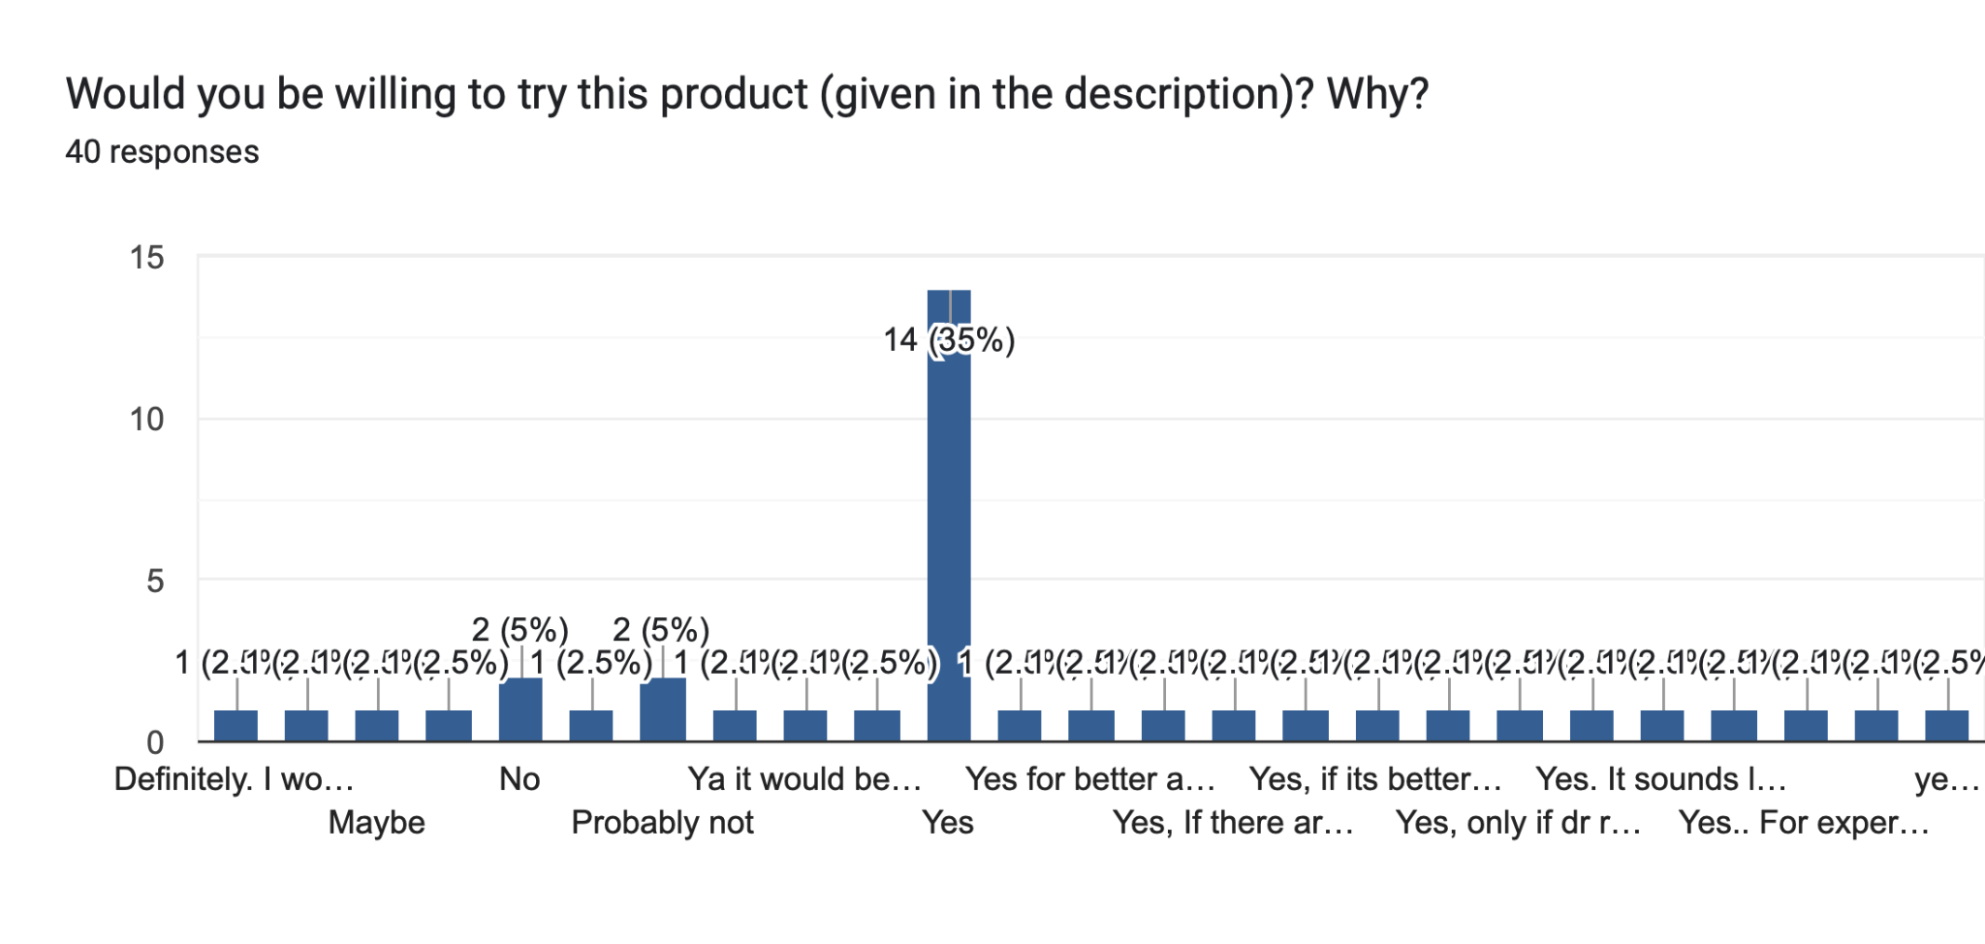
Finding #1: Customers are willing to try

Slide 10
Customer Journey
01
03
04
02
Learns Technology
Results & Reuse
Customer then learns about the technology that solves the problem.
Customer sees the results and adopts the product
Learns Problem
Tries the product
Customer learns the problem through their dentists.
Customer tries the product.

Slide 11
Finding #2: Education is crucial
We found educating the customer is central in selling the technology. User needs to learn the problem and its severity before they try the product.
Means of educating
Dentists: We found dentist are the primary contact of dental education for most of our customers.
Word of mouth: Second biggest means for dental education comes from family and friends.

Slide 12
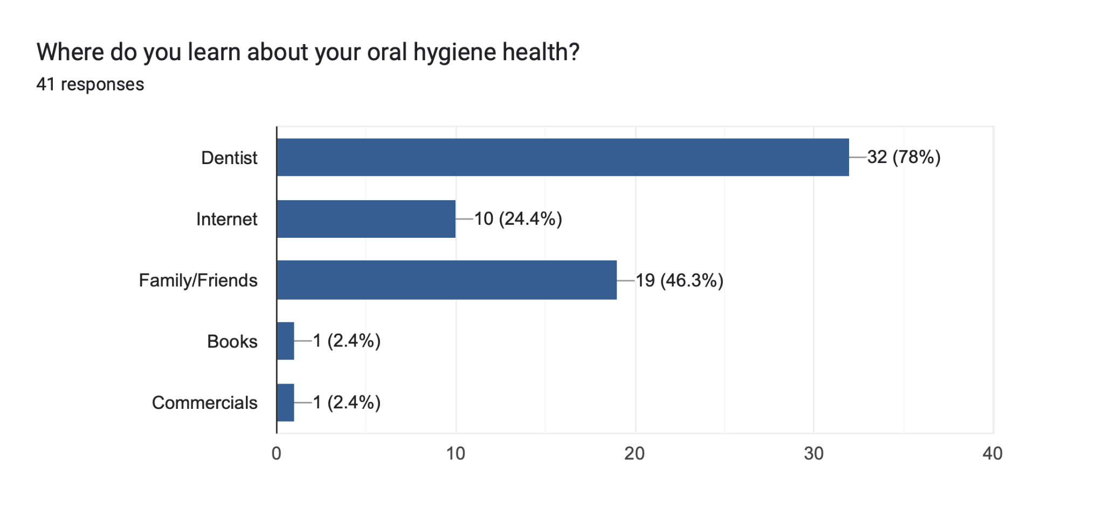
Education sources

Slide 13
Finding #3: Feel the product Customer choice
Safety, feel the effectiveness
Ease of Use
Safety and effectiveness of the product.
If the product is easy to use and not unconventional.
Price
Market Availability
If price is not too high.
If it is readily available in the market.

Slide 14
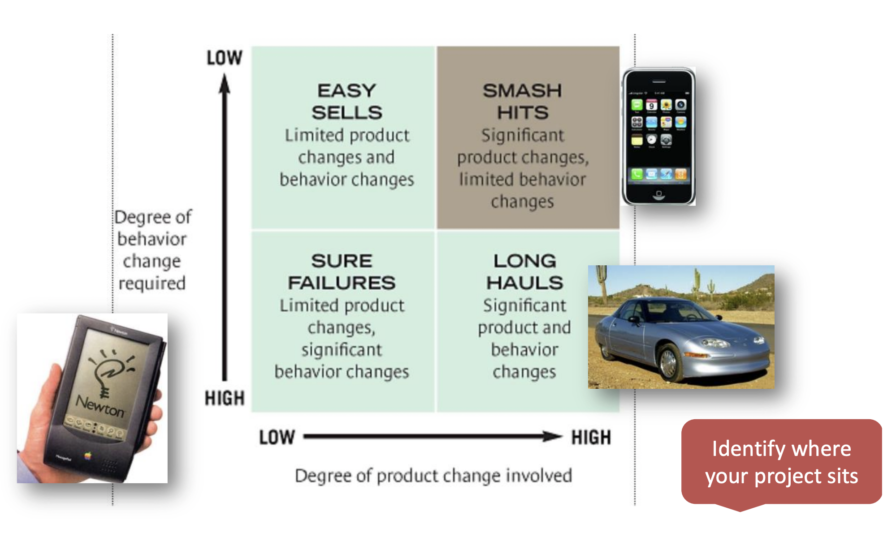
Smash Hits

Slide 15
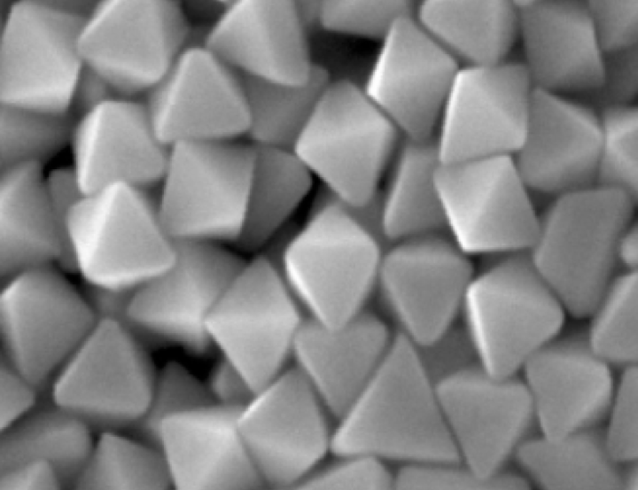
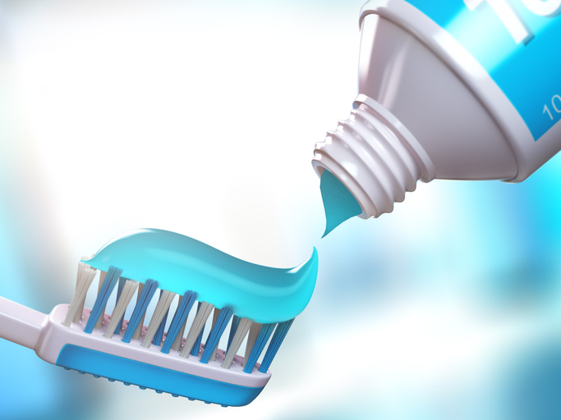
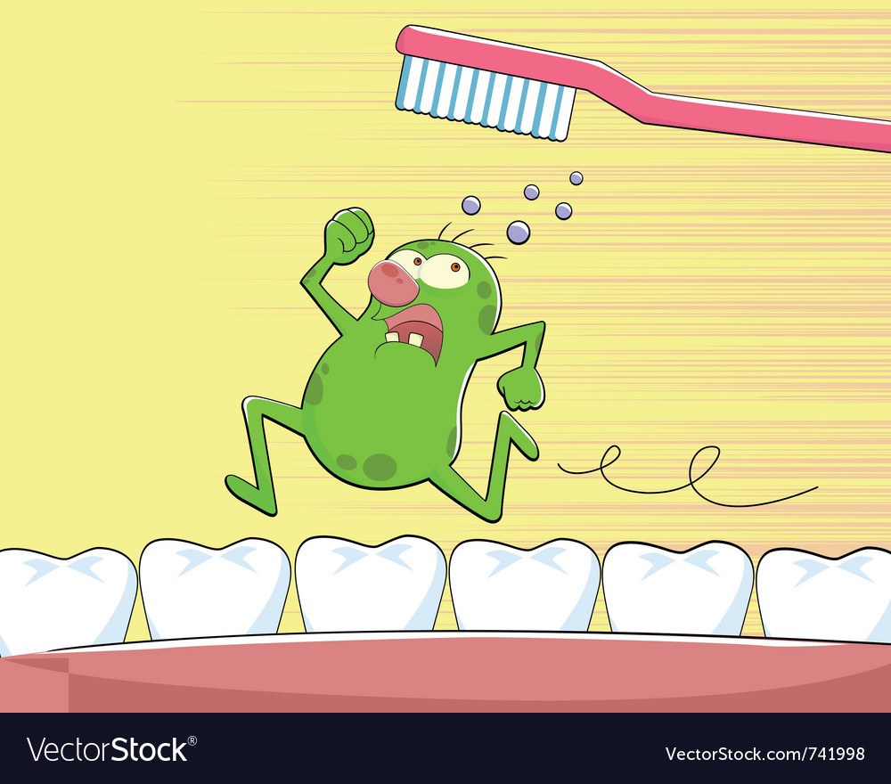

Introducing Technology
Briefly introducing the technology to the user and how it will help solve the problem.

Slide 16
Finding #4: Network effect
“I have used Colgate for my entire life. I trust the brand.”
“I use my roommate’s toothpaste.”
“My wife buys all the dental products.”

Slide 17
Summary slide

Slide 18
Questions to be answered in future research
Take feedback from early users and find out if customer is satisfied with the product.
Know about market penetration alternatives licensing or new brand or combined?
How can we help customers “feel” the product?

Slide 19
References
https://docs.google.com/spreadsheets/d/1wOCyCoLWcqsVFqRG5NNDBkGsRbBYWdCCPIXRHoly69A/edit?usp=sharing

Slide 20
Thanks!
Do you have any questions?

Slide 21
FINANCIALS + POSITIONING (Due in final presentation)
Identify specific product positioning (application + segment)
Develop revenue model (3-year pro forma) for market launch, w/ inputs + assumptions
Address risks / challenges, especially regarding market demand and timing
Deadline: Tuesday of Week 14, 12 noon

Slide 22
GO-TO-MARKET STRATEGY + LAUNCH (Due in final presentation)
Review (final) customer-specific findings + segment strategy / product positioning
Provide market (TAM/SAM/SOM) + competitive analysis (re current gold standard)
Outline go-to-market strategy + risks / challenges (including possible no-go decision)**
Include customer interview data + secondary sources (in supporting docs, no write-up)
Complete self + team evaluations, comments
Deadline: Tuesday of Week 15 (4/25), 12 noon (presentations + Q&A during finals week) *Use model from Week 5 PPT (below)
**Use model from Week 6 PPT (below)
Week 5 Model (“Eager Sellers & Stony Buyers”)

Slide 23
Line of questions to work on
Who did you interview (numbers, roles)?
What are some preliminary findings?
What are surprises, changes you discovered?
How has that impacted your perspective on the tech + commercialization opportunity?
What do you still need to find out?

